Slide 2


Slide 3


Slide 4


X

Slide 5


Sampling
Sampling from Data Distributions
X

Slide 6
Sampling
When working with data, we often are limited in our ability to collect all the data in existence.
More likely, we are collecting a sample from a larger population that we use to estimate characteristics of the whole population.
X

Slide 7
Sampling
Understanding sampling well is critical for testing out potential business decisions or strategies.
It’s unlikely that we’ll ever have access to an entire population of data, so when setting up ideas to test, we need to understand how sampling plays a role.
X

Slide 8
Sampling
Important Note:
Certain modern tech companies with huge billion+ user bases (Gmail, Facebook, etc.) actually have a strategic advantage due to their scale of being able to conduct tests on enormous samples while only affecting a small percentage of users.
X

Slide 9
Sampling
Section Topics:
Sampling and Bias
The Central Limit Theorem
The Student's t-Distribution
Confidence Intervals
X

Slide 10
Sampling
Let’s begin to explore some ideas of sampling, t-tests and how sampling relates to the central limit theorem.
X

Slide 11

Sampling
We can think of sampling as grabbing data instances from a larger data distribution.
Imagine we are testing delivery via air drones and are tracking how off target packages.
X

Slide 12
Sampling
Our company is simply a logistics company, but doesn’t manufacture drones.
We want to test different brands of drones to understand their performance.
X

Slide 13
Sampling
The purpose of testing the drones is so when we go into production, we can have some idea of how accurate different brands of drones are in their delivery targets.
X

Slide 14
Sampling
We could begin to think about our testing as a sample of the larger future population of all drone deliveries.
X

Slide 15
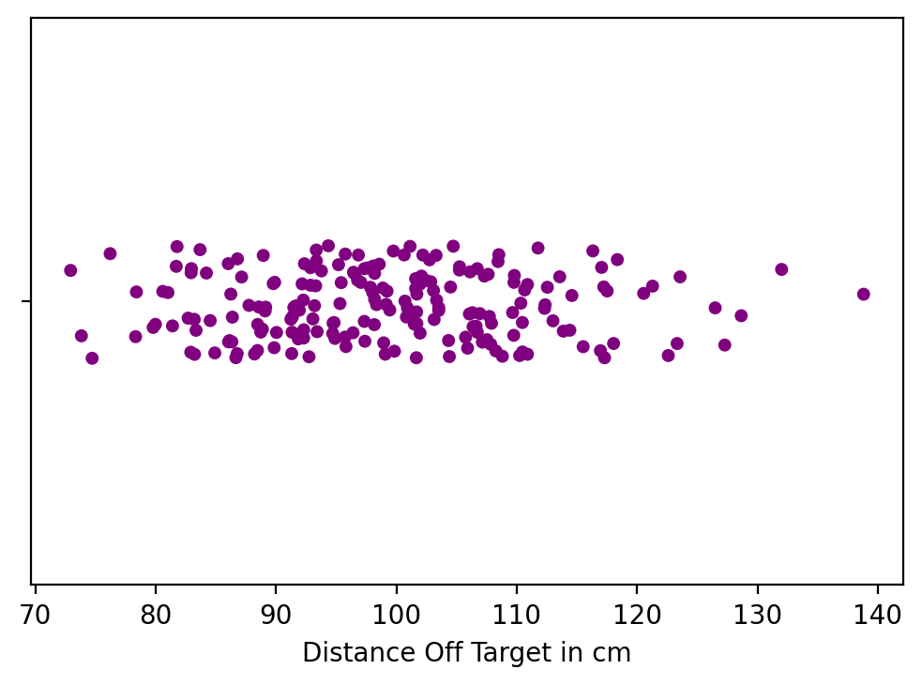
Sampling
We could track the measurements of how far off the packages were to create a sample distribution.
X

Slide 16
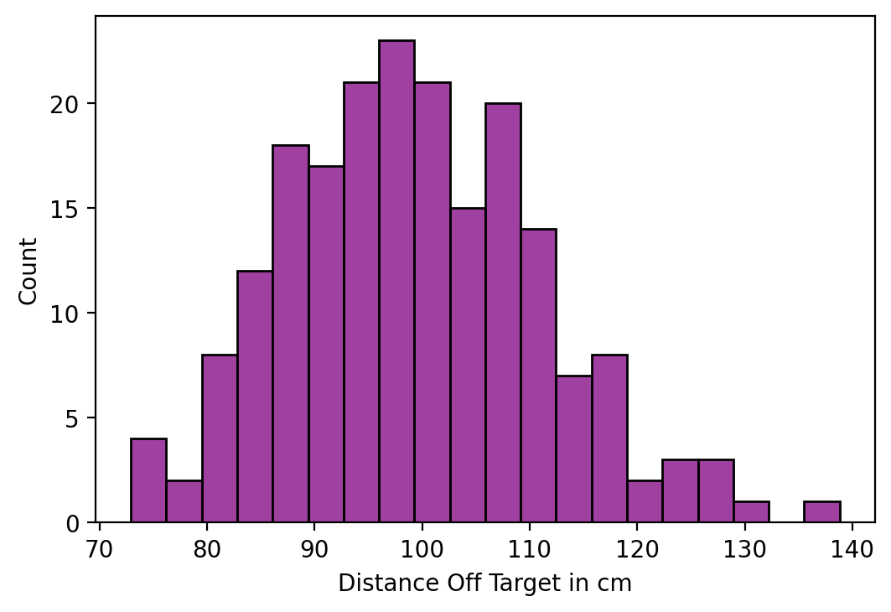
Sampling
We can then further organize this data as a histogram, creating a data distribution:
X

Slide 17
Sampling
We can see that if we were to randomly choose a single data point, it would likely be close to 100.
X

Slide 18
Sampling
So far, these are all concepts we’ve learned when discussing data distributions.
X

Slide 19
Sampling
But now, let’s present two different scenarios and how the knowledge learned in this section can help us!
X

Slide 20

Drone Scenario 1
Now imagine we had some partners across the globe conduct their own tests, creating a data distribution for another drone.
However… they didn’t write down the brand name!
X

Slide 21
Drone Scenario 1
Using the idea of sampling from data distributions, would there be a way to see if the data sets were likely to come from the same population (the same brand of drone)?
X

Slide 22
Drone Scenario 1
We could begin to treat this situation as a t-test, testing to see if the sampling from both drones were likely to come from the same population. (Two-sample t-test)
X

Slide 23
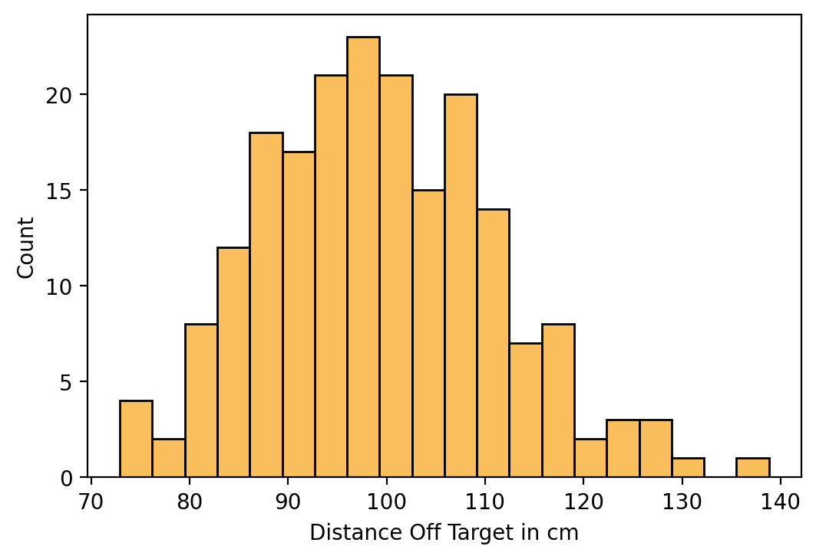
Drone Scenario 1
We can compare samples from the data distributions created from both drones, and use a p-value to see the likelihood of being the same brand.
X

Slide 24
Drone Scenario 1
Later on in this section we’ll dive into the mathematics of how to conduct such a test, but let’s consider another scenario that sampling and t-tests can help with.
X

Slide 25
Drone Scenario 1
Later on in this section we’ll dive into the mathematics of how to conduct such a test, but let’s consider another scenario that sampling and t-tests can help with.
X

Slide 26
Drone Scenario 2
Imagine that we now are in a situation where we’ve tested the original drones, but want to see if we can make modifications to them to improve their performance.
X

Slide 27
Drone Scenario 2
Imagine that we now are in a situation where we’ve tested the original drones, but want to see if we can make modifications to them to improve their performance.
X

Slide 28
Drone Scenario 2
We are now wanting to know if there are differences within the same population (same drone brand) after a change.
X

Slide 29
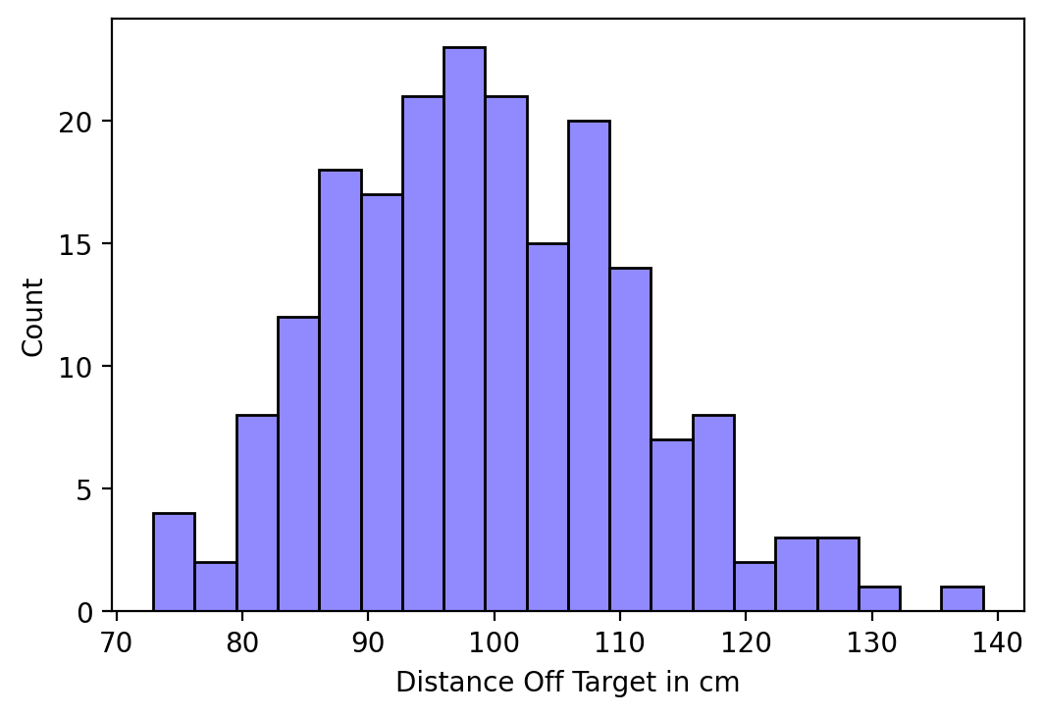
Drone Scenario 2
We can run a paired t-test to explore the effects of the change on the same population.
X

Slide 30
Sampling
Understanding how to use sampling in conjunction with t-tests gives us powerful tools to let us know whether or not experiments worked and the ability to compare samples from data distributions to compare them against our assumptions, like belonging to the same population.
X

Slide 31
Sampling
In this section we’ll also be discussing the central limit theorem, which will reveal a fundamental property of data distribution and sampling from them.
Let’s get a high level overview of the central limit theorem and why it’s important.
X

Slide 32
Sampling
Formally defined, the central limit theorem establishes that, in many situations, when independent random variables are summed up, their properly normalized sum tends toward a normal distribution even if the original variables themselves are not normally distributed.
X

Slide 33
Sampling
The formal definition is a lot to take in!
Let’s get a clearer understanding by actually showing the central limit theorem in practice.
X

Slide 34
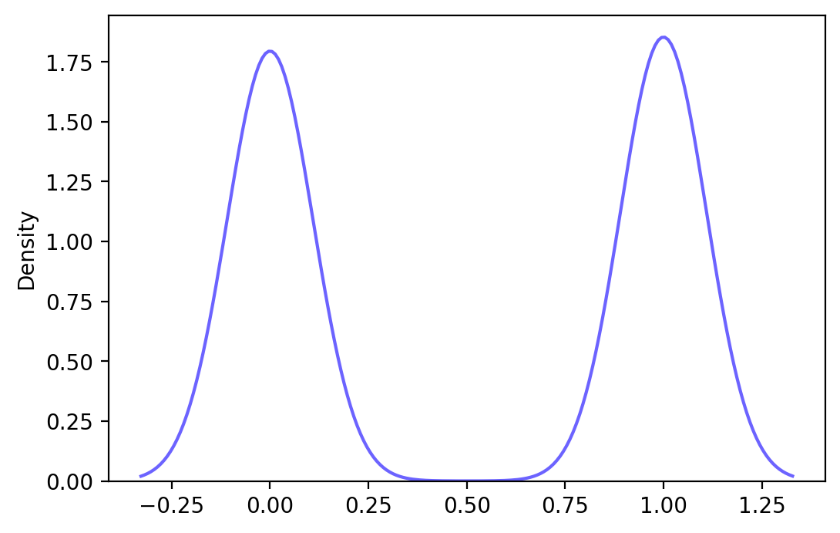
Sampling
Imagine a data distribution that displays bimodal behavior:
X

Slide 35
Sampling
Then you take a random sample from the distribution:
X

Slide 36
Sampling
Then you take the mean of that random sample:
0.43
X

Slide 37
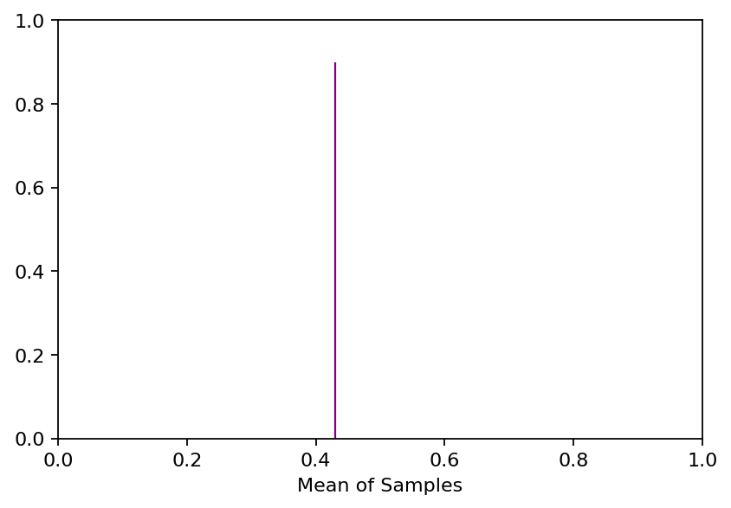
Sampling
Then plot the mean of the sample on its own plot.
0.43
X

Slide 38
Sampling
Now we repeat this process of random sampling, calculating mean, and plotting…
X

Slide 39
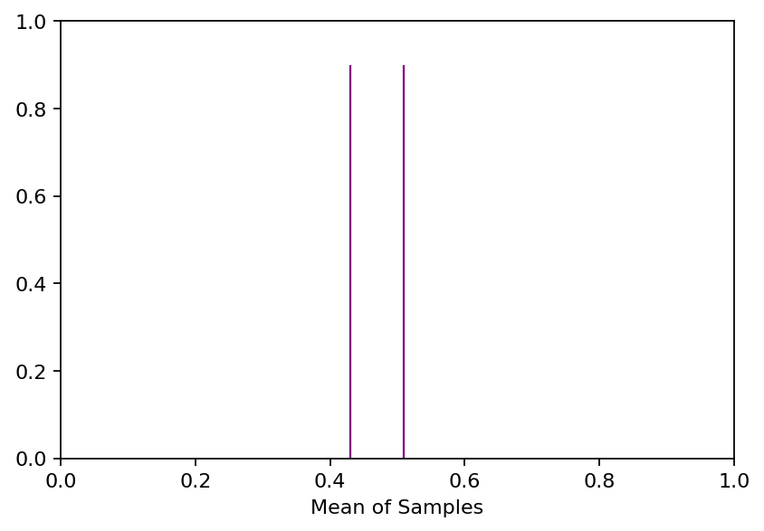
Sampling
Now we repeat this process of random sampling, calculating mean, and plotting…
0.51
X

Slide 40
Sampling
Do this many more times and a behavior will arise…
0.51
X

Slide 41
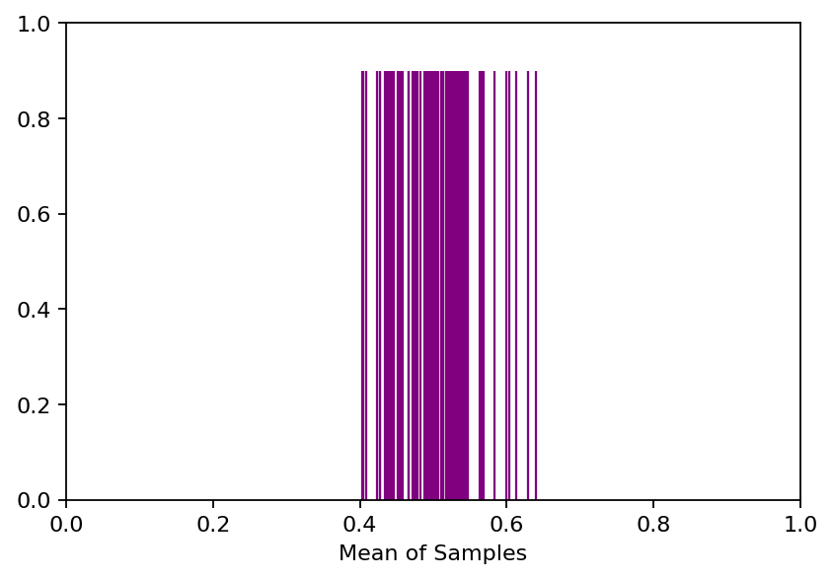
Sampling
Central limit theorem states that the means of samples will be normally distributed!
X

Slide 42
Sampling
We could create a histogram from the means of the samples:
X

Slide 43
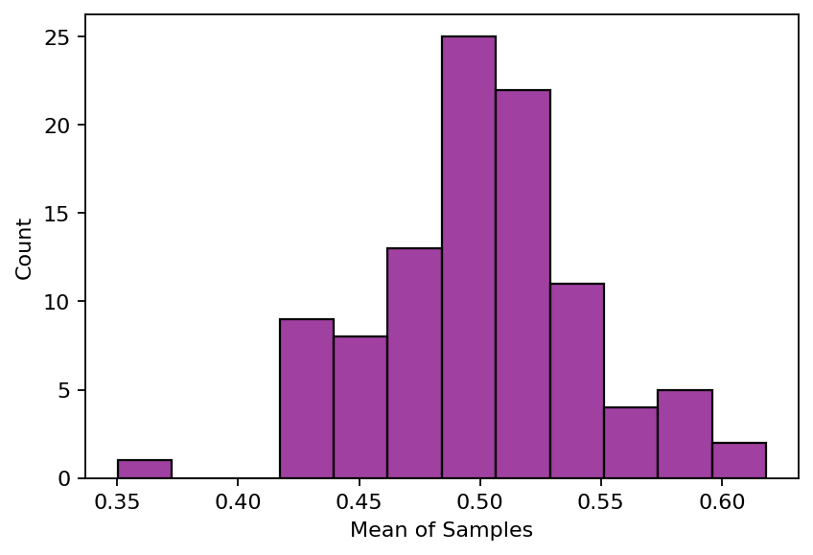
Sampling
We could create a histogram from the means of the samples:
X

Slide 44
Sampling
The mean of the samples will be normally distributed around the mean of the data distribution!
X

Slide 45
Sampling
What is absolutely crucial about the central limit theorem (CLT) is that this behaviour is true for almost any data distribution!
(An example exception is the Cauchy distribution).
X

Slide 46
Sampling
So while this is a very interesting property of data distributions and sampling them, why would this be useful in the real world?
X

Slide 47
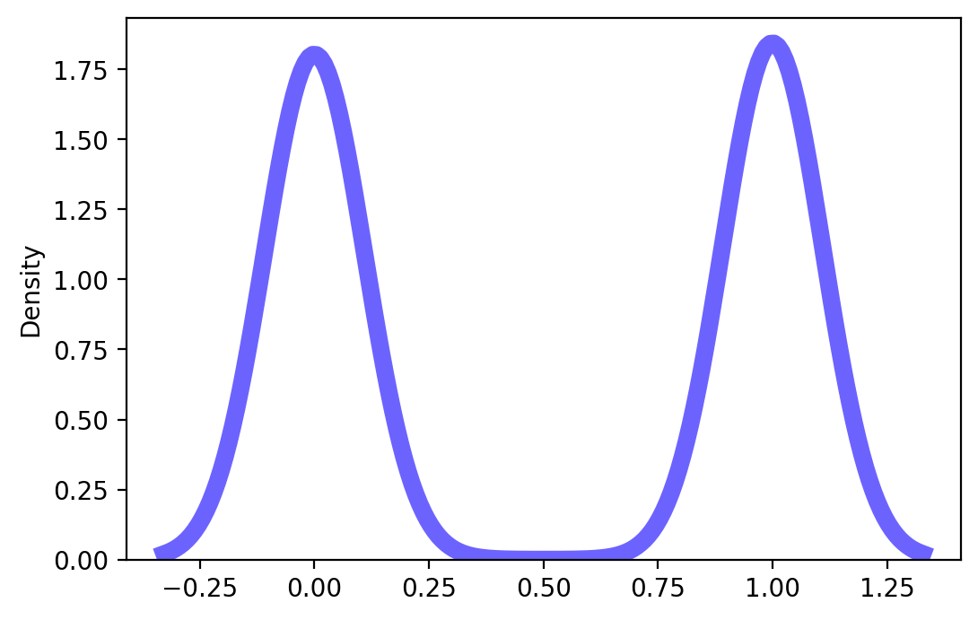
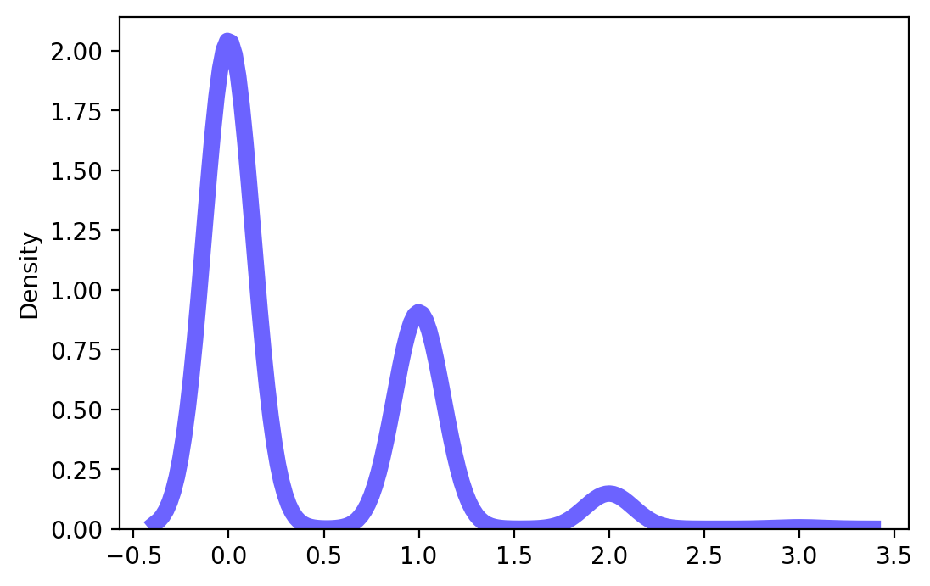
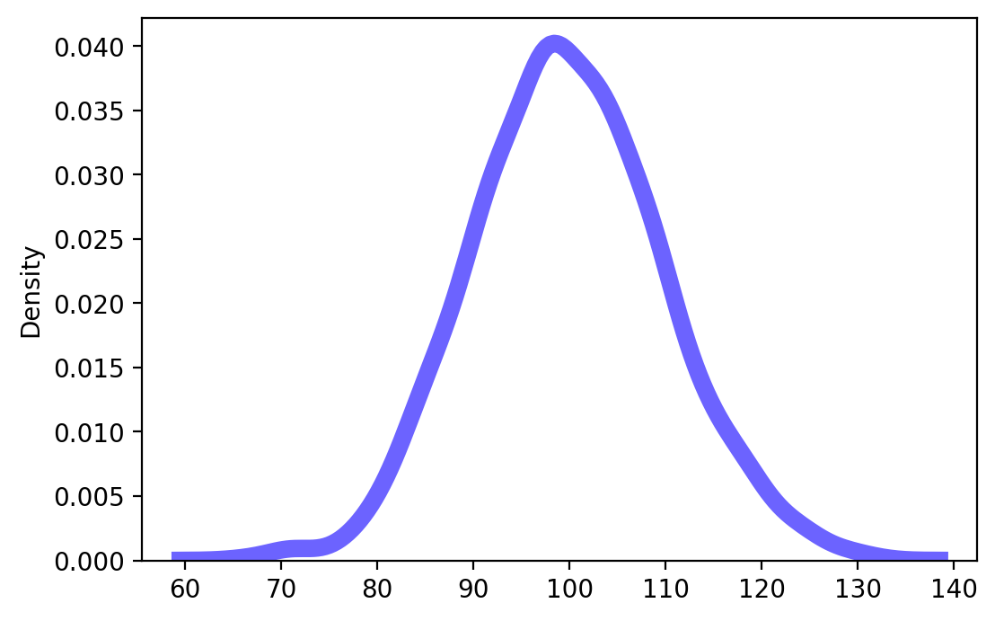
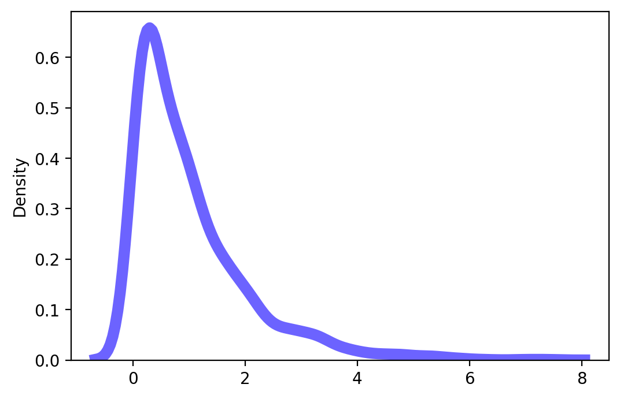
Sampling
We often don’t know the true distribution our data comes from.
X

Slide 48
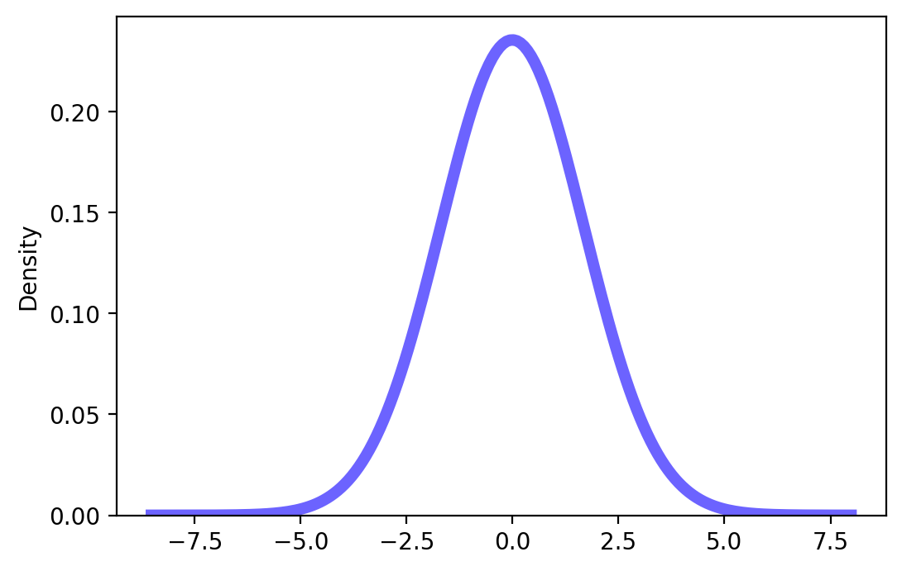
Sampling
CLT allows us to disregard the original data distribution since the sample means will be normally distributed.
X

Slide 49
Sampling
With the normally distributed means, we can then perform the t-tests on the samples.
X

Slide 50
Sampling
Let’s continue to learn more about the power of sampling and how we can use it to conduct t-tests.
X

